Slide 1


Attributes of an Effective Consultant
www.culinaryoptions.com
karen@culinaryoptions.com
206-283-6740

Slide 2

“Longevity in foodservice consulting isn’t just about talent—it’s about relationships, curiosity, humility, and adaptability. Skills matter. But what sustains a career over decades is how you work with people and how you continue to grow.”
Orlando Espinosa III
Behind the Line Foodservice Consulting

Slide 3
WHAT IS A CONSULTANT?
A person who provides fee-based expert advice based on knowledge they possess that a client needs

Slide 4

What Is Quality?
What Is Quality?
The degree of excellence: how good, bad, useful, etc. something is
A high level of value or excellence: superiority in kind
The degree to which a set of inherent characteristics fulfills requirements
Taking the time to define quality is the foundation of performance and credibility.
Be precise as a clear definition creates structure, trust & improvement.
Don’t assume everyone has the same idea of what “quality” means. It is imperative to define how a client views “quality” from the start to avoid mismatched expectations.
“Quality in a service or product is more than what you put into it. It is what the client or customer gets out of it.” Peter Drucker

Slide 5


Consultants
#1 Activity:
Lead & Educate
We help solve the client’s problem or resolve a challenge while teaching them to develop new skills for their work. We:
    Develop their core competency which strengthens their sense of self-efficacy
      Self-efficacy refers to an individual's belief in their ability to succeed in specific situations.
      It influences motivation, perseverance, and resilience in the face of challenges.
    Expand their ability to tackle challenges
    Encourage clients to remain calm in the face of significant impending change
    Lead them to greater goal-setting and achievement

Slide 6

How We Do This Leading & Educating
1. We ask open-ended questions
    about the work to help the client properly set the scope of work, which
    fosters a dialogue that can reveal layers of insight into the emotional roots of the task at hand.
    This conveys our sincere interest by listening to answers rather than talking, which
    Leads to more innovative solutions

Slide 7

2. We Listen to Their Answers
    We focus on learning to understand rather than reacting to strengthen communication and build trust
    Stay out of your own internal world; hear the client’s inner world
    We maintain eye contact while listening
    We physically reflect what we hear
    We re-articulate complex information in a way that’s acknowledged by the client
    We are the last to speak
When people perceive that someone is actively listening to them, it activates the brain reward system, so they feel more positive about the other person and better about their own experiences.

Slide 8
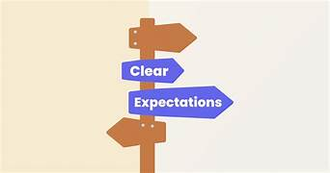

3. We Manage Expectations
We assure deliverables are clearly outlined before agreeing to a timeline
We are realistic about outcomes and timelines
We outline what happens if things change
We establish priorities in a logical order
We collect feedback regularly and send out proactive updates
We define our process clearly and set boundaries

Slide 9
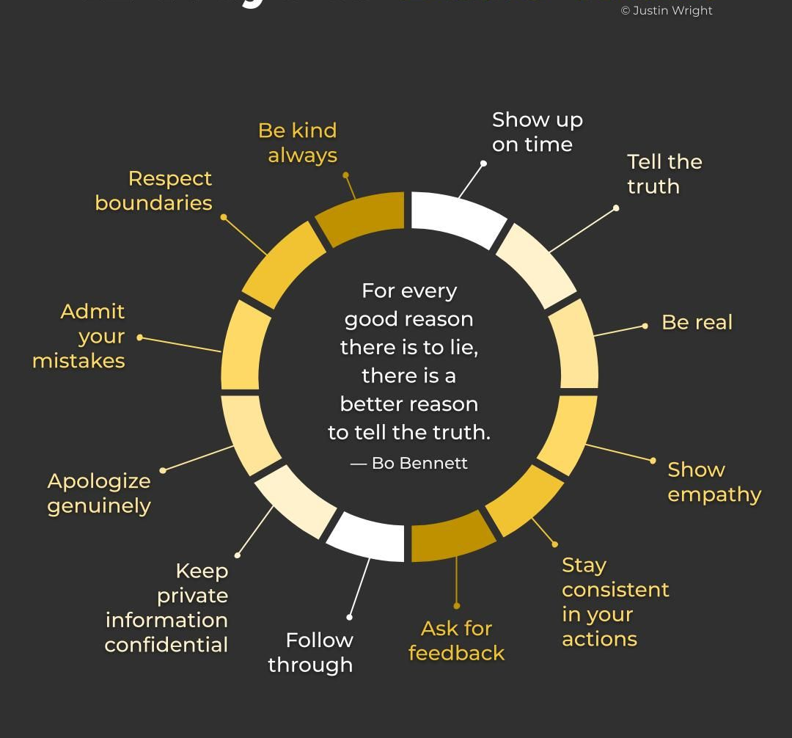
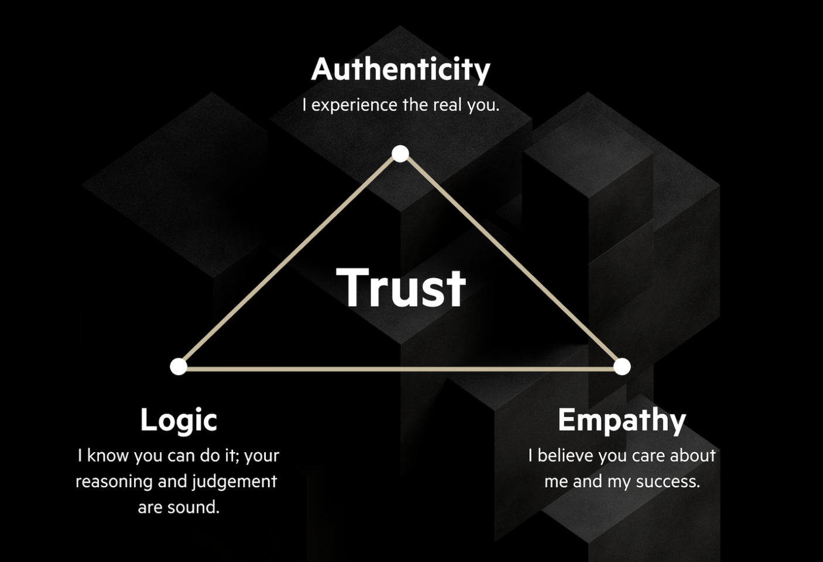
4. We Build Trust
We demonstrate understanding of the emotions and motivations of our clients
We navigate challenging situations with empathy
We build rapport with clients by developing a shared vocabulary
We do what we say we were going to do

Slide 10

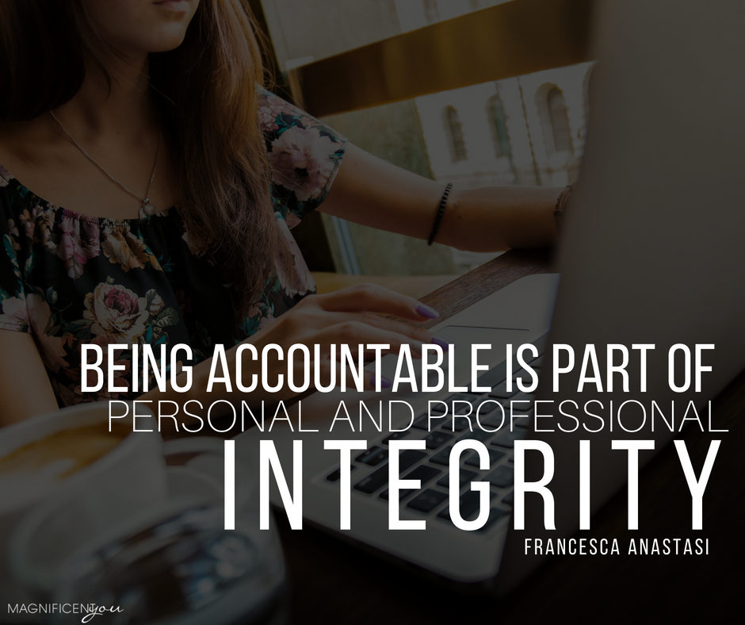
5. We Are Accountable
We take responsibility for all actions, inactions, and decisions
We never blame or make excuses
We responsibly communicate any deviation from expectations originally established
We keep our word

Slide 11

Above all - we remain Real
We Invest in the relationship, not just the scope
We strengthen their credibility and foster long-term partnerships through mutual respect
We shift the conversation from sales-driven to solution-driven; position ourselves as a trusted partner
We celebrate key milestones and accomplishments with the client

Slide 12
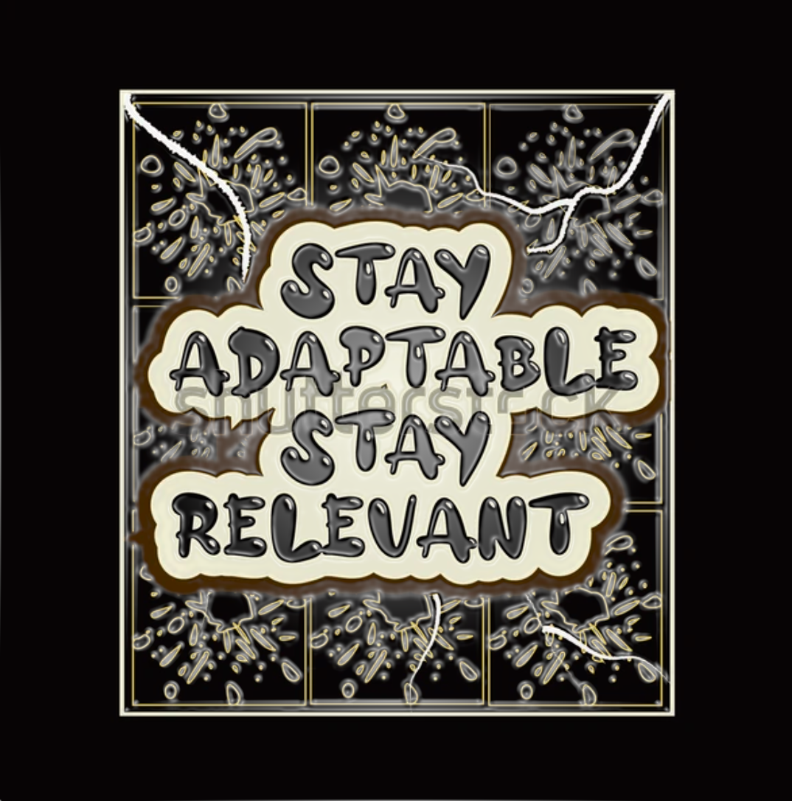
And we remain relevant
We look outside our industry
We adjust our strategy if needed
We practice mindfulness: self-reflection fosters great adaptability
We seek new tools and enhance our skill
We leverage technology to improve our efficiency
We embrace change and use it as an opportunity to innovate
We devour information & crave knowledge
We seek feedback from clients
We exchange insights with peers and industry leaders

Slide 13

In short -
We Exercise Mindfulness
The state of active, open, intentional attention to the present.
The ability to be aware of your thoughts, feelings and surroundings moment to moment in a non-judgmental way.
We force our brain to work in different ways and can begin to expand and strengthen its cognitive function.
We make a concerted effort to build new mental skills.

Slide 14

Never forget to ask:
WAS THE PROJECT
A SUCCESS?
In the beginning, did you:
Step 1: Define what success means?
Step 2: Select metrics for success measurement?
Step 3: Establish baselines and targets?
Step 4: Set up tracking methods?
Step 5: Adjust measurements as needed?
Step 7: Evaluate results after completion?
If you didn’t, why not? If you did, did you utilize them? And finally, did they spell success?

Slide 15
The Future of Consulting: understanding the trends shaping today’s consulting industry and using that knowledge to build a smarter engagement strategy
The rise of AI, data, and automation are changing consulting workflows.
The growth of small firms and consulting platforms, offering specialized services but with their own limitations.
The collision of consulting with other professional services, blurring the lines between strategy, technology, and execution.
Procurement’s evolving role in driving consulting efficiency and value.

Slide 16
The Future of Consulting: other consultant firms capturing “dollar share” we may have previously owned
  Professional Services Firms: Companies that traditionally focused on operational services—like IT, HR, and engineering—are building consulting arms.
  Internal Consulting Teams: Large corporations are investing heavily in internal consulting capabilities, sometimes offering their expertise externally.
  Turnaround and Restructuring Firms: As economic cycles shift, turnaround specialists have positioned themselves as leaders in crisis management and restructuring—areas traditionally dominated by management consultancies.
  Marketing and Communications Agencies: The line between consulting and marketing strategy has also blurred.
  Business Intelligence and Market Research Companies: Firms that provide data-driven insights (e.g., Gartner, Forrester, Euromonitor) are increasingly positioning themselves as strategic partners, offering guidance on everything from industry trends to competitive benchmarking.

Slide 17
Economic and Strategic Consequences: Risk, Reward, and Reinvention
In the rarefied air of management consulting, where slide decks and sage counsel have long commanded kingly fees, a tectonic shift is underway. McKinsey & Company, the industry’s perennial bellwether, recently disclosed that a full quarter of its fee pool is now staked on measurable client outcomes—a decisive move away from the billable-hour model that has defined the sector for generations. This is no mere pricing tweak; it signals a profound re-architecture of how value is created, delivered, and monetized in the advisory world. The old world of time-and-materials is fading, replaced by a landscape where outcomes are king and accountability is institutionalized.

Slide 18
The Human Element Is More Important Than Ever.
“The future will be won by consultants who combine genuine expertise with technological sophistication.” System Six
Even though technology has and will continue to change & disrupt facets of consulting, this is a fundamentally human business.
Clients want consultants who have equal doses of technical skill and emotional intelligence—who know not just data but organizations and human effects.
This is the age where AI has democratized information, so the data itself isn’t valuable, but the inference is. Where information is useless—insight comes in.
Consulting companies will be built on much more flexible business models. They will keep core teams but bring in networks of independent experts as needed for specific assignments.
Forming a character-forming consortium with complementary boutique firms will enable the ability to take on more projects.

